Slide 1
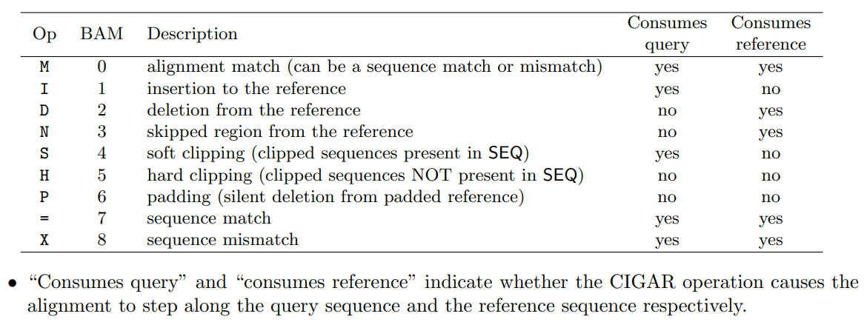
SAM format
CIGAR (Compact Idiosyncratic Gapped Alignment Report) string

Slide 2
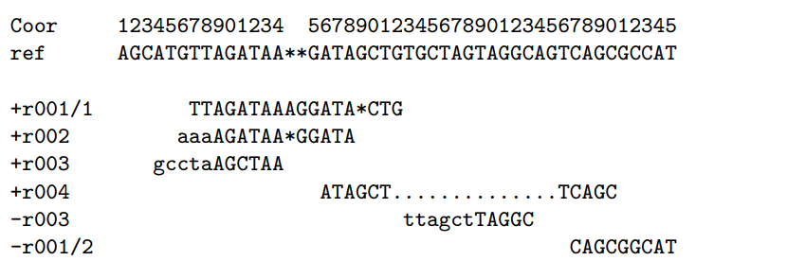
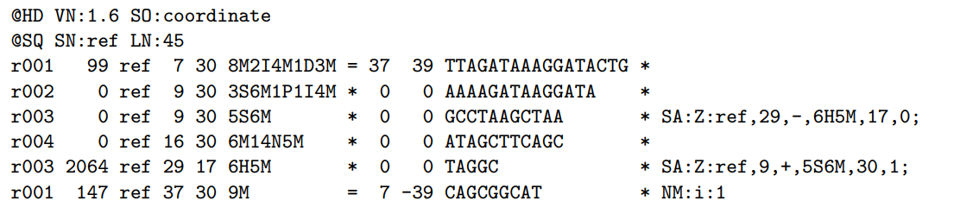
SAM format
Examples of CIGAR strings

Slide 3
SAM format https://samtools.github.io/hts-specs/SAMv1.pdf
Suppose we have the following alignment
It will look like this in the SAM file
Coordinates are 1-based

Slide 4
SAM format https://samtools.github.io/hts-specs/SAMv1.pdf
Suppose we have the following alignment
It will look like this in the SAM file
Coordinates are 1-based

Slide 5
SAM format https://samtools.github.io/hts-specs/SAMv1.pdf
Suppose we have the following alignment
It will look like this in the SAM file
Coordinates are 1-based

Slide 6
SAM format https://samtools.github.io/hts-specs/SAMv1.pdf
Suppose we have the following alignment
It will look like this in the SAM file
Coordinates are 1-based

Slide 7
SAM format https://samtools.github.io/hts-specs/SAMv1.pdf
Suppose we have the following alignment
It will look like this in the SAM file
Coordinates are 1-based

Slide 8
SAM format https://samtools.github.io/hts-specs/SAMv1.pdf
Suppose we have the following alignment
It will look like this in the SAM file
Coordinates are 1-based

Slide 9
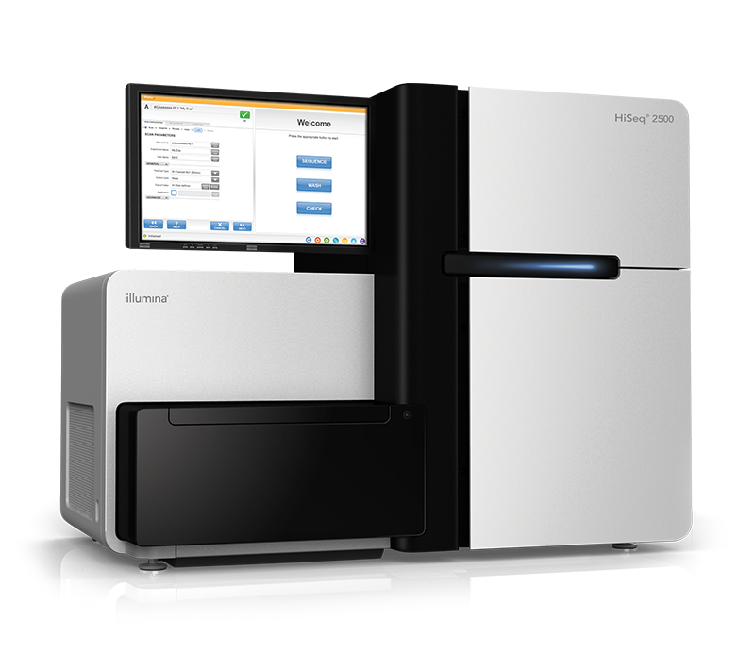
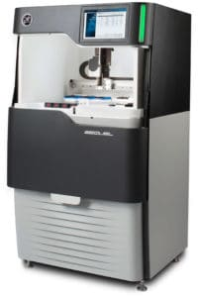
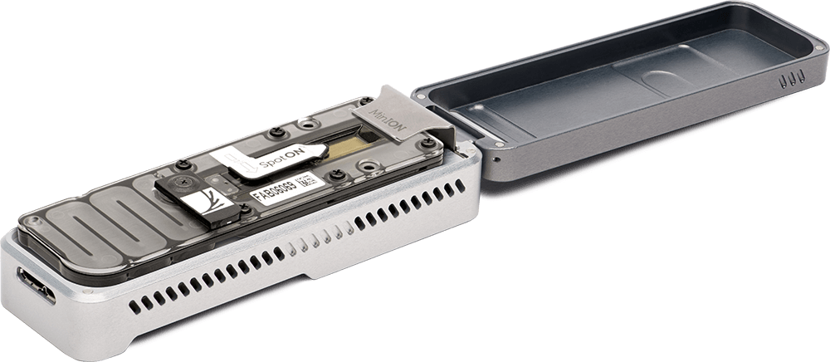
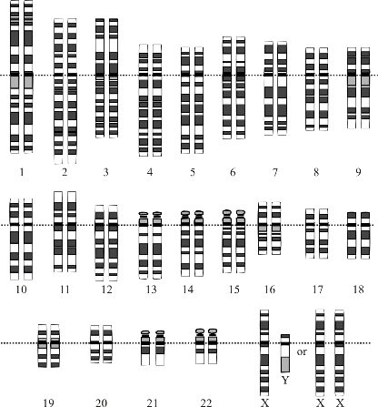
Overview
Multiple copies of DNA
Fragments of
150 - >500,000 bases
Read the Sequences
Shred &
(Size select)
Scaffolding
Pairs of Reads of ~150-250 bp each
Contig assembly
CAAGCTGAT...
…GTTTGGAAC
OR Long reads 10+ kb each
Image Courtesy: National Human Genome Research Institute

Slide 10
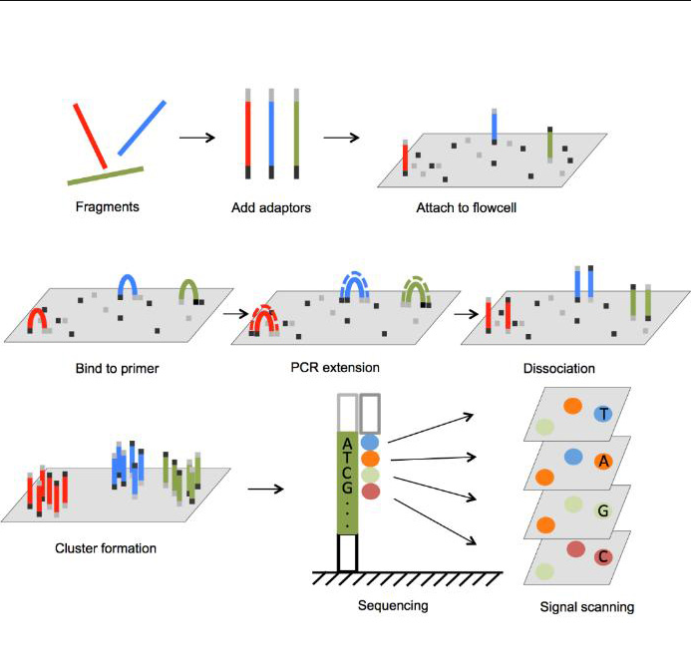
Sequencing technologes: Illumina
Overview of Illumina Sequencing by Synthesis Workflow | Standard SBS chemistry
Souurces: https://www.bmkgene.com/dnarna-sequencing-illumina-sequencer-product/, Illumina

Slide 11
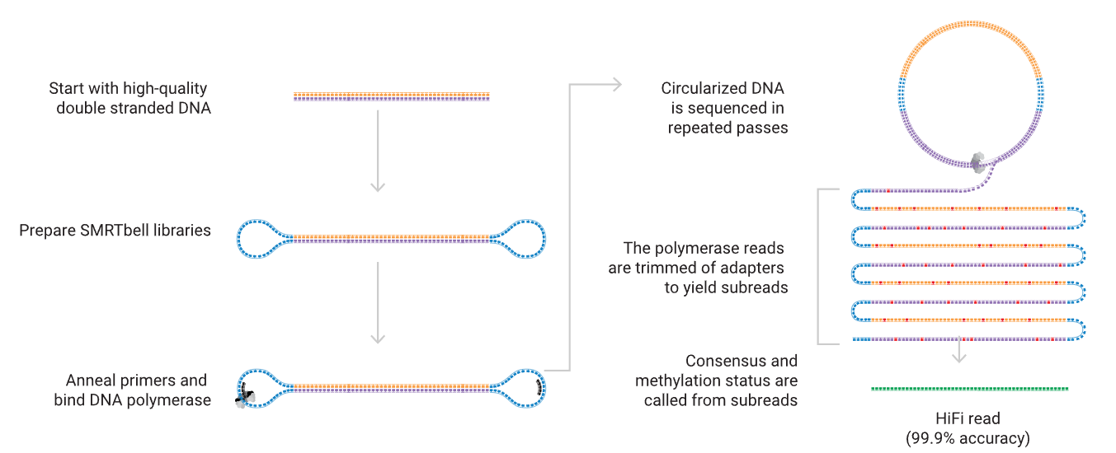
Sequencing technologies: PacBio CLR/HiFi
Sequencing 101: from DNA to discovery — the steps of SMRT sequencing - PacBio
Source: PacBio

Slide 12
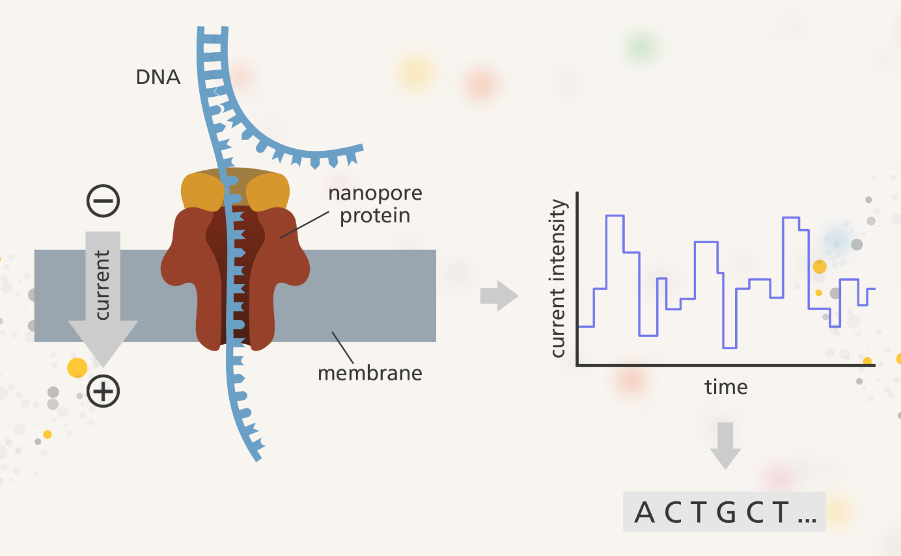
Sequencing technologies: Oxford Nanopore
How nanopore sequencing works | Oxford Nanopore Technologies

